Slide 1
MICCAI Paper Reviews
July – 19
Bishal

Slide 2
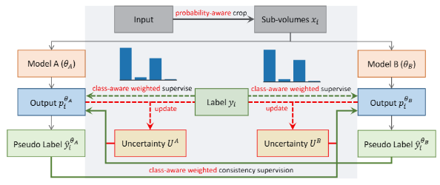
Calibrating Label Distribution for Class-Imbalanced Barely-Supervised Knee Segmentation MICCAI – 2022 May 2022
Paper Link
Main Contribution - Class Imbalance Problem
Modify loss function into class aware loss function
Uncertainty aware sampling supervision

Slide 3
Calibrating Label Distribution for Class-Imbalanced Barely-Supervised Knee Segmentation MICCAI – 2022 May 2022
Paper Link
Loss -
These weights are determined based on the distribution of labels in the data. Specifically, they count the number of voxels (3D pixels) for each category in the labeled data and construct a weighting coefficient for each category. The weighting coefficient for a category is inversely proportional to its frequency, raised to the power of a constant (1/3 from their experiments)
Uncertainty aware sampling –
Calculates a uncertainty value (how unsure the model is about its predictions)
Creates a binary mask from the uncertainty values of voxels that is used while training the model to focus more on the categories that the model is less confident about.

Slide 4
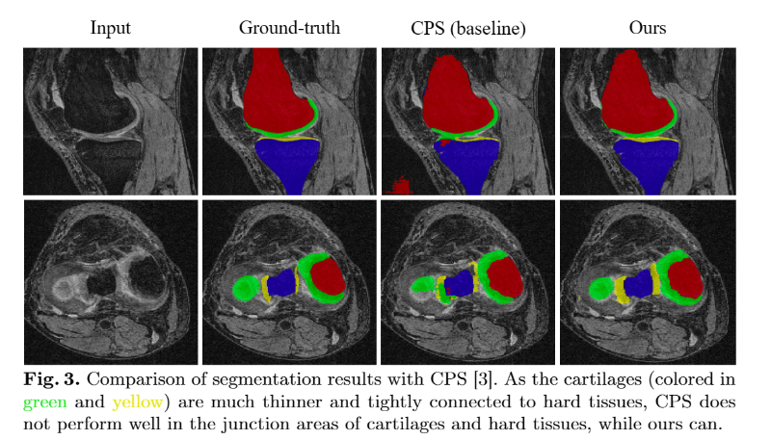
Calibrating Label Distribution for Class-Imbalanced Barely-Supervised Knee Segmentation MICCAI – 2022 May 2022
Paper Link
Results
CPS accuracy – 83.6%
Paper accuracy – 87.2%

Slide 5
Exploring Smoothness and Class-Separation for Semi-supervised Medical Image Segmentation MICCAI – 2022 June 2022
Paper Link
Main Contribution – Addressing Blur Pixels and Low-contrast regions
Pixel-level Smoothness: This concept is about making sure that the model's predictions don't change too much for small changes in the input image. The authors use a technique called adversarial training to achieve this. They introduce small changes (or perturbations) to the input image and make sure that the model's predictions remain consistent. This is done by comparing the prediction for the original image and the slightly perturbed image, and then adjusting the model to minimize the difference between these predictions. This process helps the model to be more robust and less sensitive to small changes in the input, which is important for tasks like image segmentation.
Inter-class Separation: This concept is about making sure that the model can clearly distinguish between different classes (or categories) in the image. The authors use a prototype-based strategy for this. They first select a subset of features from the labeled data as prototypes for each class. Then, they encourage the features of each class to be close to their corresponding prototype. This helps to make each class distribution compact and separate from other classes. In other words, it helps the model to clearly distinguish between different classes in the image.

Slide 6
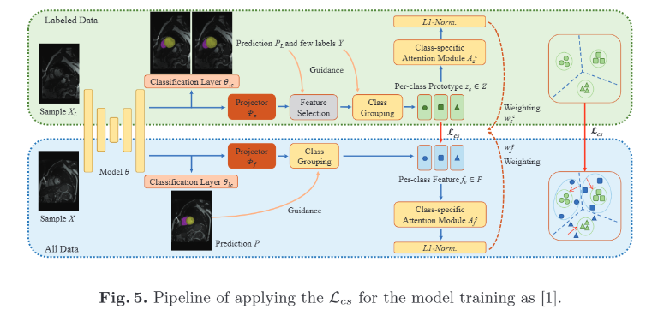
Exploring Smoothness and Class-Separation for Semi-supervised Medical Image Segmentation MICCAI – 2022 June 2022
Paper Link

Slide 7
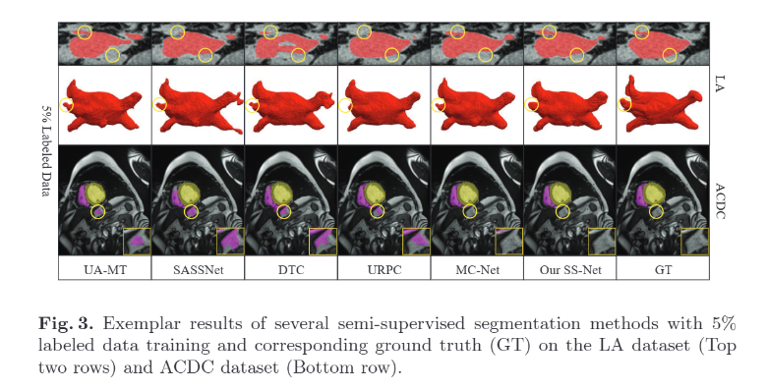
Exploring Smoothness and Class-Separation for Semi-supervised Medical Image Segmentation MICCAI – 2022 June 2022
Paper Link
Results
SASSNet accuracy – 81.60 (MICCAI 20)
MC-Net accuracy – 83.59% (MICCAI 21)
Paper accuracy – 86.33% (MICCAI 22)

Slide 8
Free Lunch for Surgical Video Understanding by Distilling Self-Supervisions MICCAI – 2022 Sept 2022
Paper Link
Main Contribution – Distilled transfer learning using contrastive learning
Semantic-Preserving Training – Preserve the learnt features from MoCov2 model and learn via contrastive learning
Given an input, two transformations are made and passed through MLP layers to obtain final representations. Contrastive loss (InfoNCE loss) is used to measure the mililarity and compute loss.
The distillation loss is used to measure the difference between the similarity matrices of the teacher model and the student model. The teacher model is the model that has been trained using a semantic-preserving training scheme, and the student model is the model that is being trained on the surgical data.

Slide 9
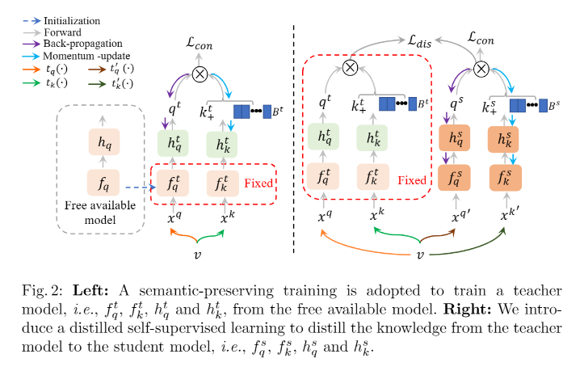
Free Lunch for Surgical Video Understanding by Distilling Self-Supervisions MICCAI – 2022 Sept 2022
Paper Link

Slide 10
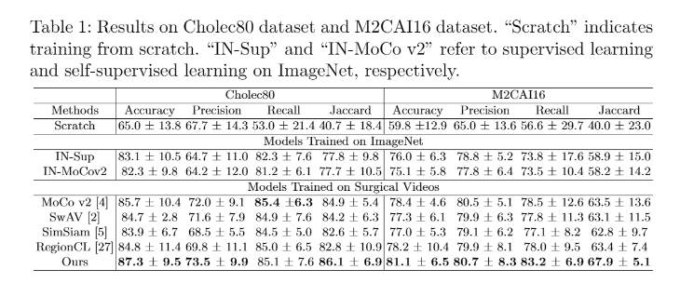
Free Lunch for Surgical Video Understanding by Distilling Self-Supervisions MICCAI – 2022 Sept 2022
Paper Link
Results

